Slide 1



Technical Evaluation of GPT-4 and GPT-4-Turbo Reflective Listening Response Generation with the Counsel Chat Dataset
Dipendra Pant¹ & Suresh Kumar Mukhiya² ¹Department of Computer Science, NTNU, Trondheim, Norway ¹Department of Child and Adolescent Psychiatry, Clinic of Mental Health Care, St.Olav University Hospital, Trondheim, Norway ²Tryg Norge, Norway ²Western Norway University of Applied Sciences, Bergen, Norway

Slide 2
Outlines
Introduction
Method
Results
Discussion
Conclusion

Slide 3

What is Reflective Response ?
Communication strategy
involves expressing understanding
reflecting back what the other person has said
demonstrate empathy
Pivotal in mental health clinical practice
Notes:
Reflective listening is a communication strategy that involves understanding and reflecting back what the other person has said, to ensure clarity and demonstrate empathy. This technique is particularly effective in counselling, conflict resolution, and everyday conversations to foster deeper understanding and connection.
It involves: Paraphrasing
Reflecting Feelings
Clarifying
Summarizing
Let's consider a scenario involving a person feeling overwhelmed at work.
Person A: "I'm so stressed with all the deadlines at work. I feel like I can't handle it anymore."
Person B: "It sounds like you're really overwhelmed by your workload and the pressure of meeting all those deadlines."
Person A: "Exactly. It's just too much sometimes."
Person B: "It must be really tough to manage everything on your own. Have you thought about talking to your manager about it?"
In this example, Person B's reflective listening response helps Person A feel understood and supported, which can alleviate some of the stress and anxiety they're experiencing. It also opens the door for further conversation about potential solutions, promoting a healthier mental state.
In summary, reflective listening is a powerful tool that can enhance mental health by providing emotional support, improving relationships, reducing stress, and fostering a deeper understanding of oneself and others.
Pivotal for supporting patients and enabling recovery in mental health clinical practice

Slide 4


Reflective Response, Example ?
I'm so stressed with all the deadlines at work. I feel like I can't handle it anymore.
Person A
It sounds like you're overwhelmed by your workload & the pressure of meeting all those deadlines.
Reflecting back & reflecting feelings
Person B
Exactly. It's just too much sometimes.
Person A
It must be tough to manage everything alone. Have you thought about talking to your manager about it?
Reflecting feelings & empathy
Person B
Notes:
Reflective listening is a communication strategy that involves understanding and reflecting back what the other person has said, to ensure clarity and demonstrate empathy. This technique is particularly effective in counselling, conflict resolution, and everyday conversations to foster deeper understanding and connection.
Let's consider a scenario involving a person feeling overwhelmed at work.
Person A: "I'm so stressed with all the deadlines at work. I feel like I can't handle it anymore."
Person B: "It sounds like you're really overwhelmed by your workload and the pressure of meeting all those deadlines."
Person A: "Exactly. It's just too much sometimes."
Person B: "It must be really tough to manage everything on your own. Have you thought about talking to your manager about it?"
In this example, Person B's reflective listening response helps Person A feel understood and supported, which can alleviate some of the stress and anxiety they're experiencing. It also opens the door for further conversation about potential solutions, promoting a healthier mental state.
In summary, reflective listening is a powerful tool that can enhance mental health by providing emotional support, improving relationships, reducing stress, and fostering a deeper understanding of oneself and others.

Slide 5
Research Questions ?
How effectively can GPT-4’s (GPT-4 & GPT-4-Turbo) generate high-quality reflective listening responses on the Counsel Chat dataset?
How do the generated responses compare in terms of length, content variety, and richness?
How does GPT-4’s perform in terms of sentiment and emotional depth when crafting empathetic and supportive reflective listening responses?

Slide 6
Counsel Chat dataset ?
Source:
Scrape of CounselChat.com's forum.
Content:
Expert responses from licensed clinicians to client queries.
Dataset Columns:
questionID, questionTitle, questionText, questionLink, topic, therapistInfo, therapistURL, answerText, upvotes, views
Statistic | question | answer
Count | 1383 | 1383
Mean | 294.81 | 1521.91
Std | 264.03 | 6972.60
Min | 26 | 11
25% | 147 | 599.5
Median | 232 | 959
75% | 349 | 1466.5
Max | 2703 | 223973
Table 1: Data summary statistics
Notes:
Scrape of CounselChat.com's forum which is a platform where therapists respond to client questions

Slide 7
Method
Data Preparation
Question
(questionTitle, questionText,
Topics)
Model Response
Evaluate GPT-4
Generated Response With Evaluation Metrics
GPT-4
June 2023
Compare GPT-4 & GPT-4 Turbo Evaluation Metrics Results
Context
Model Response
Evaluate GPT-4 Turbo
Generated Response With Evaluation Metrics
GPT-4 Turbo
April 2024
Response length : 150 tokens
Temperature :
0.7 (balances creativity and coherence)
Notes:
Context : You are a mental health counsellor. Your goal is to provide empathetic, supportive, and reflective responses to clients' questions. Focus on understanding the clients' concerns and offering thoughtful and compassionate guidance.
max_tokens=150 limits the response length to 150 tokens.
temperature=0.7 balances the response creativity and predictability.

Slide 8
Methods: Evaluation Metrics
BLEU Scores
ROUGE Scores
Length Analysis
Content Analysis
Quality of generated text matches with the reference texts
Length, frequent words
Sentiment Analysis &
Emotion Detection
Uses VADER -1 (negative) to 1 (positive) scale
Notes:
BLEU measures how closely the machine-generated text matches the reference texts in terms of precision.
ROUGE measures the quality of the generated text based on how much it overlaps with the reference texts. It primarily focuses on recall, i.e., the proportion of relevant information in the reference texts that is captured by the generated text.
VADER (Valence Aware Dictionary and sentiment Reasoner): Uses the -1 to 1 scale

Slide 9
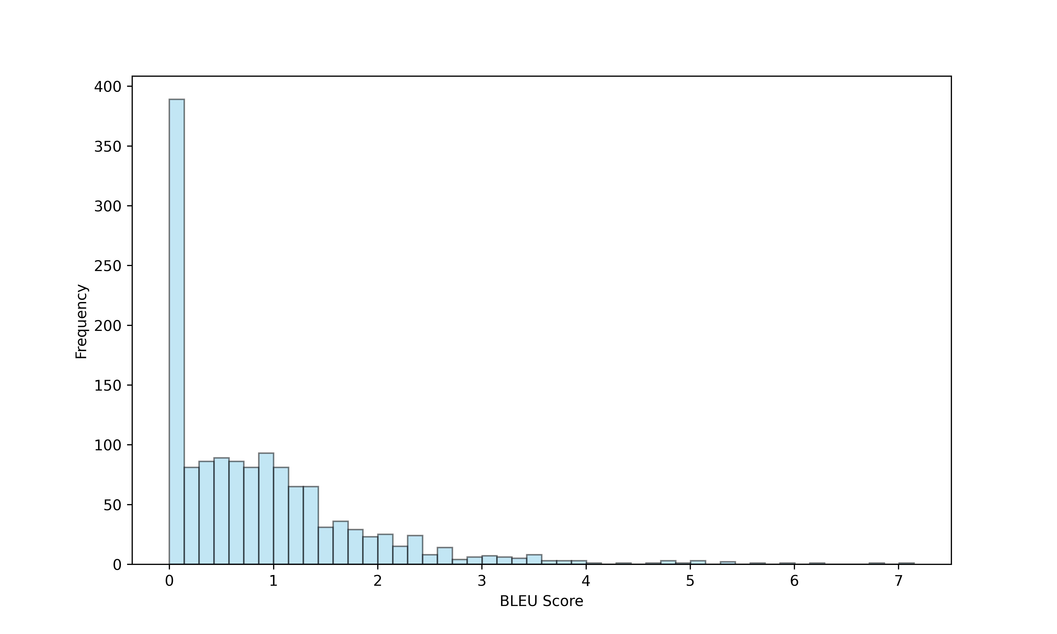
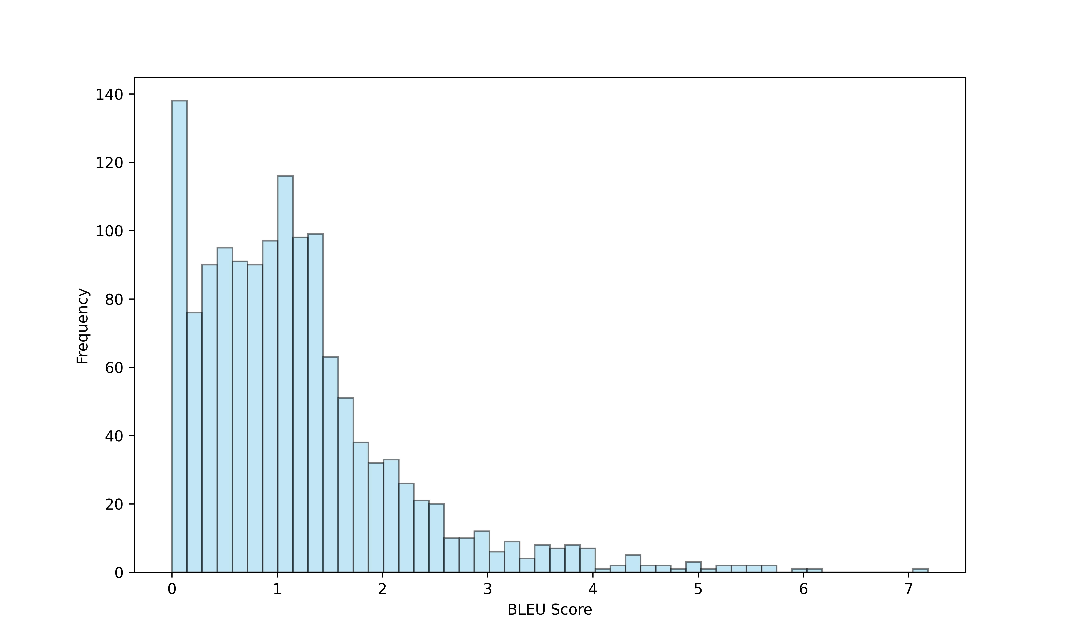
Results: Evaluation Metrics (BLEU & ROUGE)
GPT-4
GPT-4-Turbo
ROUGE type | GPT-4 | GPT-4 Turbo
ROUGE-1 | 0.2543 | 0.2936
ROUGE-2 | 0.0359 | 0.0418
ROUGE-3 | 0.1276 | 0.1383
GPT-4-Turbo outperforms GPT-4
Notes:
BLEU measures how closely the machine-generated text matches the reference texts in terms of precision.
ROUGE measures the quality of the generated text based on how much it overlaps with the reference texts. It primarily focuses on recall, i.e., the proportion of relevant information in the reference texts that is captured by the generated text.
VADER (Valence Aware Dictionary and sEntiment Reasoner): Uses the -1 to 1 scale

Slide 10
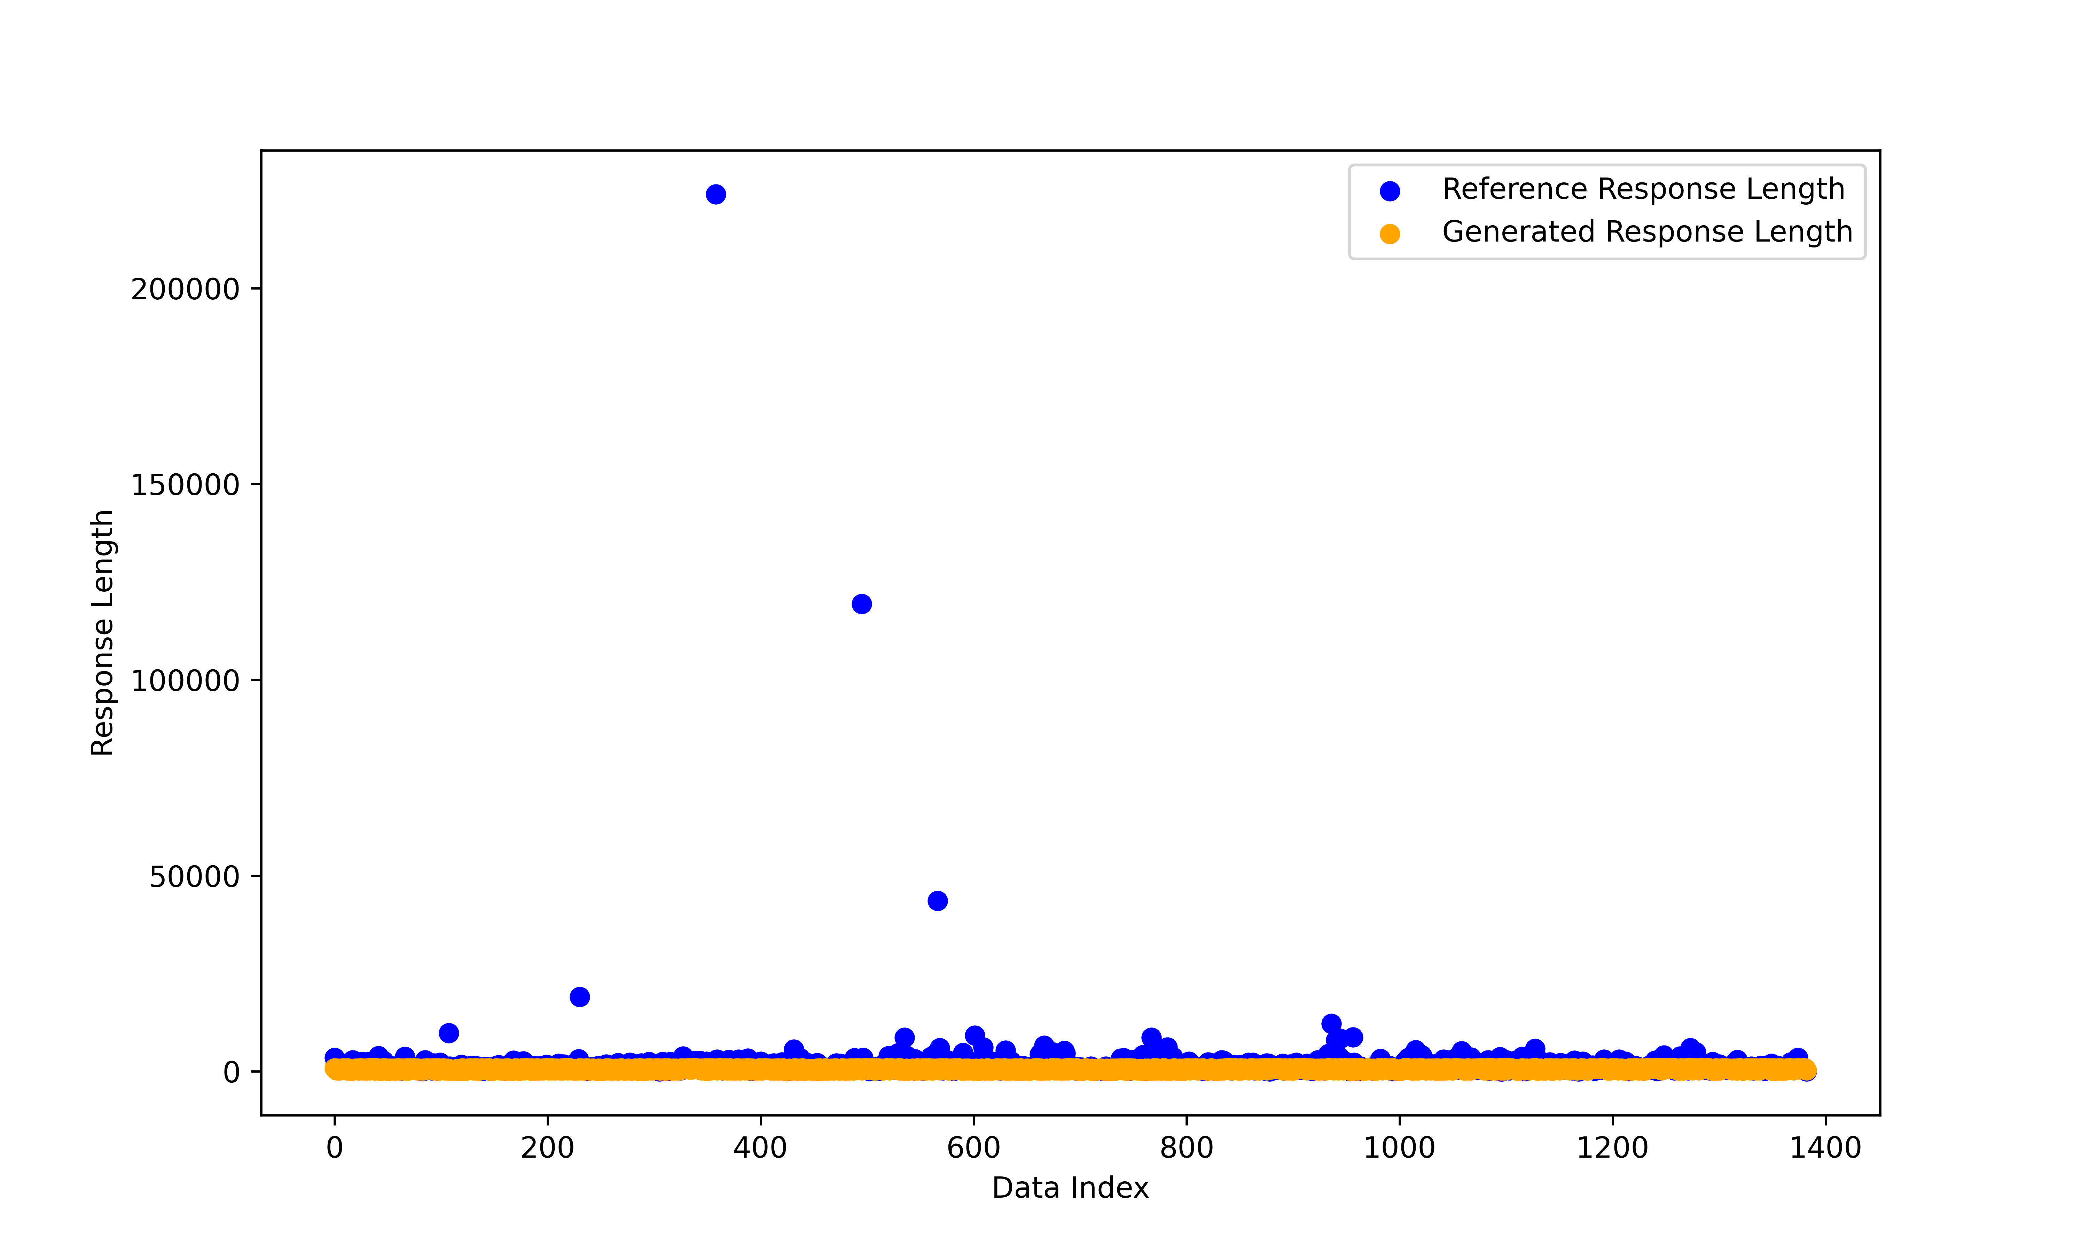
Results: Evaluation Metrics (Length & Frequent Word)
GPT-4 Turbo: More contextually relevant & possessive
GPT-4: More nuanced or emphatic words
Length almost equivalent with reference response
Notes:
BLEU measures how closely the machine-generated text matches the reference texts in terms of precision.
ROUGE measures the quality of the generated text based on how much it overlaps with the reference texts. It primarily focuses on recall, i.e., the proportion of relevant information in the reference texts that is captured by the generated text.
VADER (Valence Aware Dictionary and sEntiment Reasoner): Uses the -1 to 1 scale

Slide 11
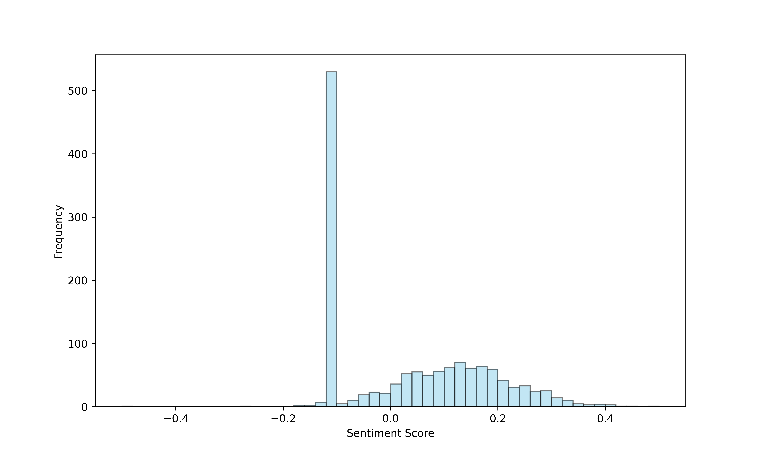
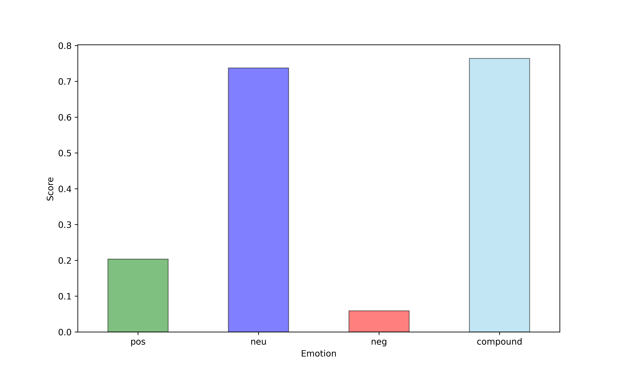
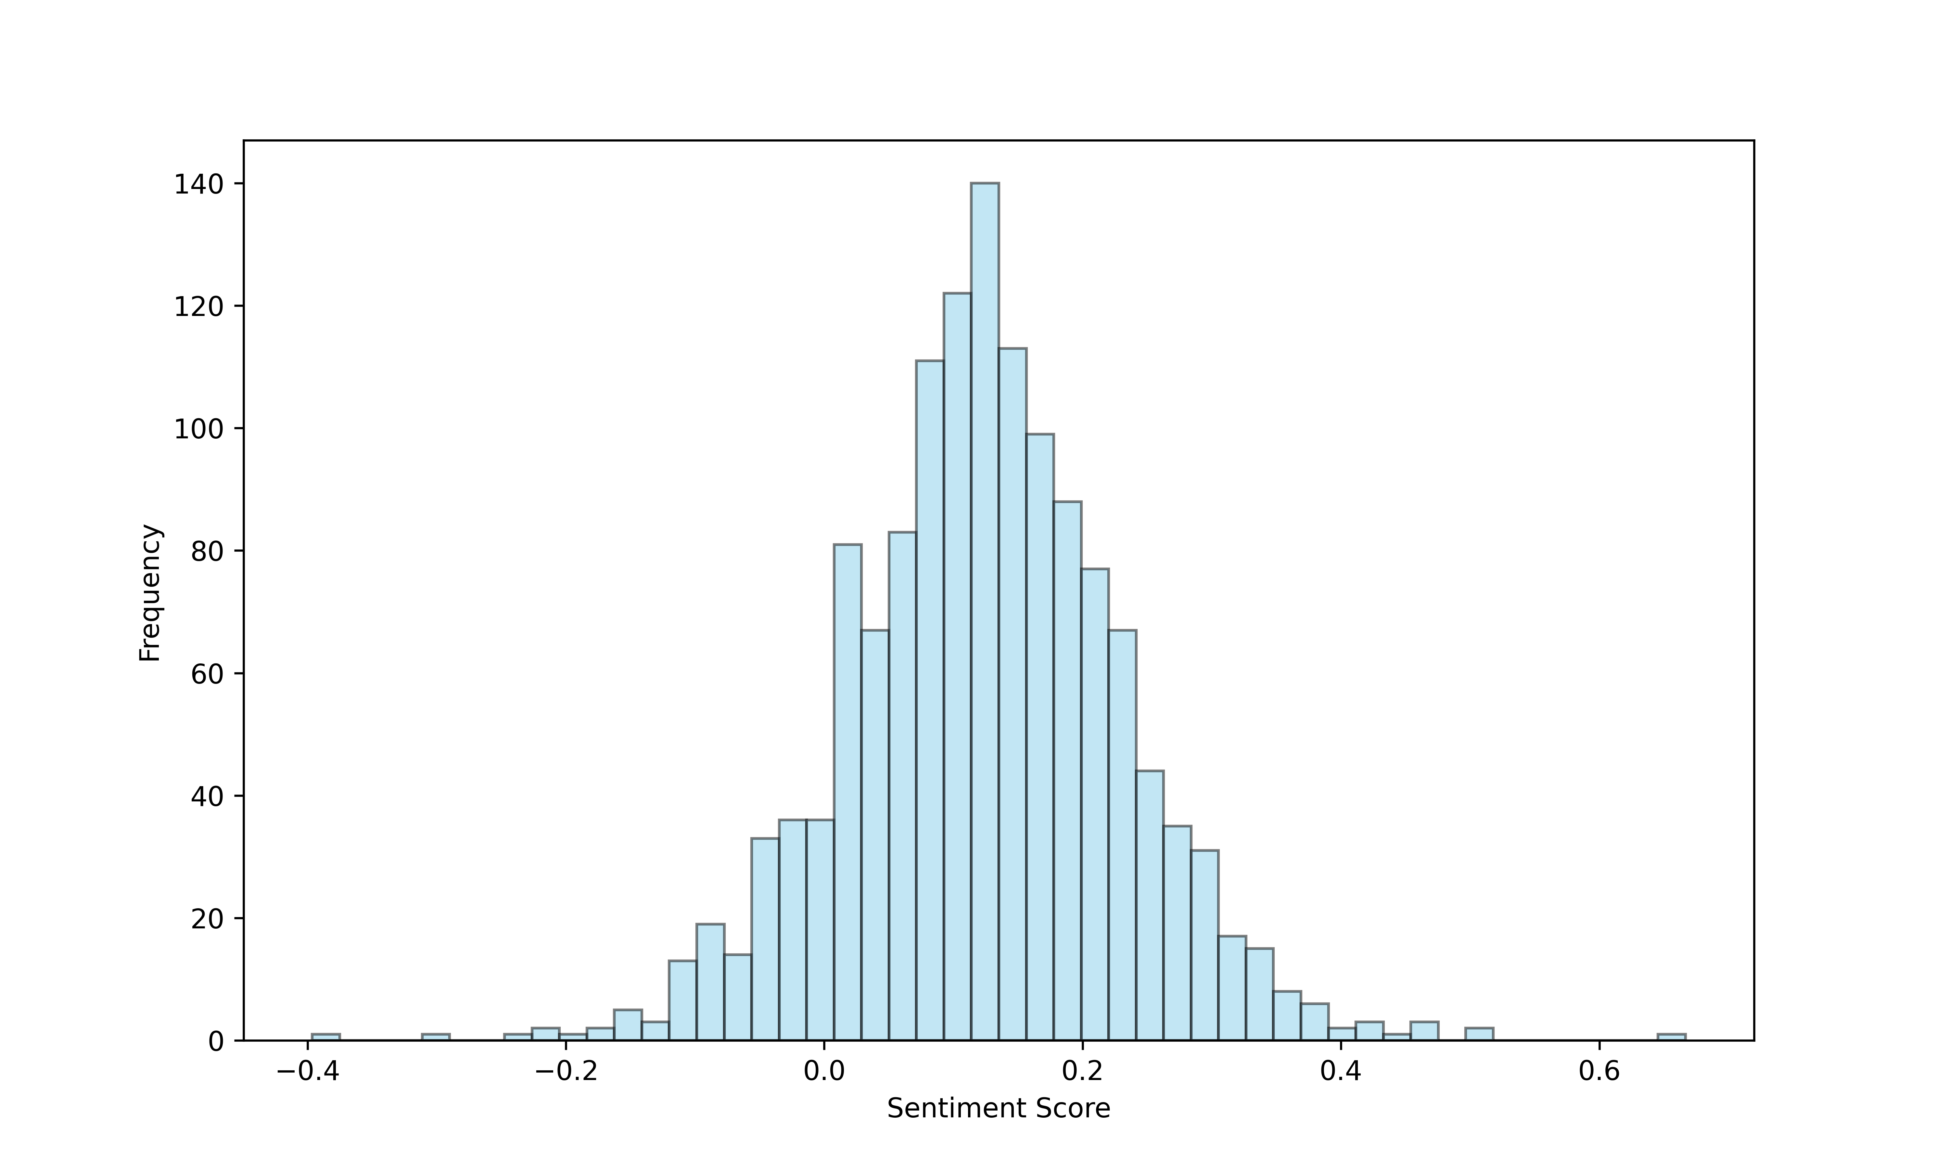
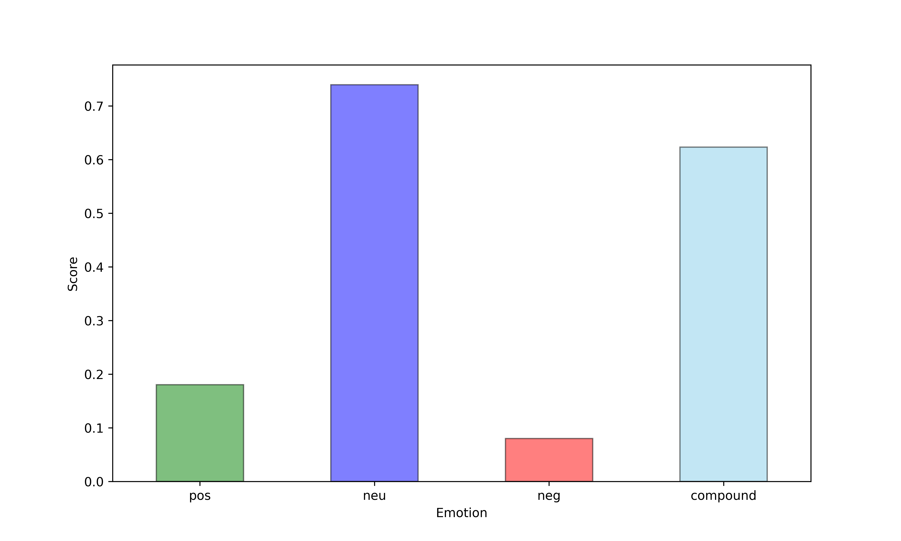
Results: Evaluation Metrics (Sentiment Analysis & Emotion Detection)
Sentiment Analysis
Emotion Detection
Overall sentiment score: 0.039
Majority
Neutral with minimal negative emotion
Overall sentiment score: 0.123
Majority
Neutral
Notes:
-1: This score represents extremely negative sentiment.
0: This score represents neutral sentiment.
1: This score represents extremely positive sentiment.
Sentiment is high level : To determine the overall tone or attitude of a text (positive, negative, or neutral)
Emotion captures finer details of specific feelings: To identify specific feelings or affective states expressed in the text

Slide 12
Discussion
Moderate BLEU scores, moderate to low ROUGE scores indicated a lack of depth and empathy (critical elements in mental health counselling).
Responses neutral to slightly positive (suitable for mental health); needs better empathetic nuances
GPT’s may have potential benefits but limitations for complex mental health needs.
Evaluations requires clinician evaluations, focus on empathy and paraphrasing capability.
Notes:
Moderate BLEU scores. However, its moderate to low ROUGE scores and qualitative analysis indicated a lack of depth and empathy as critical elements in mental health counselling.
Responses were primarily neutral to slightly positive, fitting the mental health context, but should aim to enhance the AI’s empathetic nuances
May have potential benefits but limitations exists to meet the complex needs of individuals seeking mental health support.
Evaluations involving clinicians, with focus on empathy is needed, and paraphrasing capability is needed

Slide 13
Conclusion
GPT-4-Turbo better then GPT-4 for reflective listening response generation.
Sentiment and emotion were neutral with a slight positive inclination, which is appropriate for mental health counselling.
GPT-4-Turbo's responses are more varied and richer in content, but need improvement in depth and emotional resonance.

Slide 14
Thank You ☺
Email: dipendra.pant@ntnu.no
URL: https://dipendrapant.github.io/

